Slide 1


Organizational Behavior
(MGT-502)
Lecture-9

Slide 2
Summary of
Lecture-8

Slide 3
Personality
Mean how people affect others and how they understand and view themselves, as well as their pattern of inner and outer measurable traits and
Person-situation interaction

Slide 4
Some Major Forces Influencing Personality
Cultural forces
Individual
Personality
Social class and other group membership forces
Hereditary forces
Family relationship forces

Slide 5
Today’s Topics

Slide 6
Emotions and Mood

Slide 7
Emotions defined
Feelings experienced towards an object, person or event that create a state of readiness
  emotions demand attention and interrupt our train of thought
  emotions are directed toward something

Slide 8
Emotions- Why Emotions Were Ignored in OB
The “myth of rationality”
  Organizations are not emotion-free.
Emotions of any kind are disruptive to organizations.
  Original OB focus was solely on the effects of strong negative emotions that interfered with individual and organizational efficiency.

Slide 9
Components of Attitudes
Cognitive -- thinking
Affective -- feeling
Behavioral -- doing

Slide 10
What Are Emotions?
Affect
A broad range of emotions that people experience.
Emotions
Intense feelings that are directed at someone or something.
Moods
Feelings that tend to be less intense than emotions and that lack a contextual stimulus.

Slide 11
Model of attitudes and behaviour
Beliefs
Attitude
Feelings
Emotional episodes
Behavioural
intentions
Behaviour

Slide 12
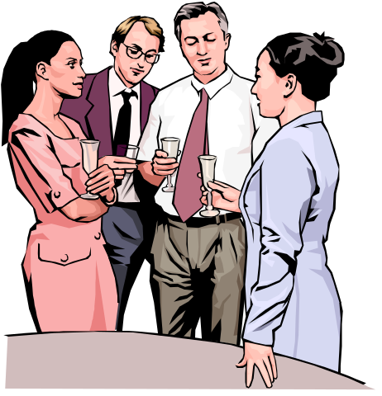
What Are Emotions?
Emotional labor
A situation in which an employee
expresses organizationally desired
emotions during
interpersonal transactions.

Slide 13
Emotional labour defined
The effort, planning and control needed to express organisationally desired emotions during interpersonal transactions

Slide 14
Emotional labour issues
True emotions leak out − especially with low emotional adaptability
Emotional dissonance causes stress
Display norms vary across cultures

Slide 15
Felt versus Displayed Emotions
Felt emotions
An individual’s actual emotions.
Displayed emotions
Emotions that are organizationally
required and considered appropriate
in a given job.

Slide 16
Emotion Dimensions
Variety of emotions
  Positive
  Negative
Intensity of emotions
  Personality
  Job Requirements
Frequency and duration of emotions
  How often emotions are exhibited.
  How long emotions are displayed.

Slide 17
Emotions
Anger
Contempt
Fear
Frustration
Happiness
Hate
Hope
Jealousy
Joy
Love
Pride
Surprise
Sadness
Enthusiasm

Slide 18
Six Universal Emotions
Happiness
Fear
Anger
Surprise
Sadness
Disgust

Slide 19
Emotion Continuum
The closer any two emotions are to each other on the continuum, the more likely people are to confuse them.
Happiness Surprise Fear Sadness Anger Disgust

Slide 20
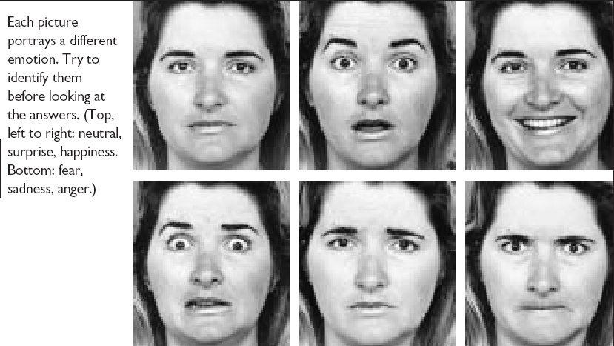
Facial Expressions Convey Emotions

Slide 21
Emotions and
Organizational
Behavior
Felt
Emotions
Displayed
Emotions
Emotional
Labor

Slide 22
Can People Be Emotionless?
Alexithymia (Greek… “lack of emotion”

Slide 23
Gender and Emotions
Women
  Can show greater emotional expression.
  Experience emotions more intensely.
  Display emotions more frequently.
  Are more comfortable in expressing emotions.
  Are better at reading others’ emotions.
Men
  Believe that displaying emotions is inconsistent with the male image.
  Are innately less able to read and to identify with others’ emotions.
  Have less need to seek social approval by showing positive emotions.

Slide 24
Emotional Intelligence
EI refers to an assortment of non-cognitive skills, capabilities, and competencies that influence a person’s ability to succeed in coping with environmental demands and pressures.

Slide 25
Emotional intelligence dimensions
Self-
awareness
Emotional
intelligence
Social
skill
Self-
regulation
Empathy
Self-
motivation

Slide 26
External Constraints
on Emotions
Organizational
Influences
Cultural
Influences

Slide 27
OB Applications of Understanding Emotions
Ability and Selection
  Emotions affect employee effectiveness.
Decision Making
  Emotions are an important part of the decision-making process in organizations.
Motivation
  Emotional commitment to work and high motivation are strongly linked.
Leadership
  Emotions are important to acceptance of messages from organizational leaders.

Slide 28
Interpersonal Conflict
  Conflict in the workplace and individual emotions are strongly intertwined.
Deviant Workplace Behaviors
  Negative emotions can lead to employee deviance in the form of actions that violate established norms and threaten the organization and its members.
    Productivity failures
    Property theft and destruction
    Political actions
    Personal aggression

Slide 29
Emotions In The Workplace
Intensity
of Emotions
Frequency
and Duration
Gender
and Emotions
Emotionless
People

Slide 30
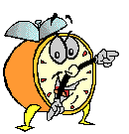
Let’s stop it here

Slide 31
Summary

Slide 32
What Are Emotions?
Affect
A broad range of emotions that people experience.
Emotions
Intense feelings that are directed at someone or something.
Moods
Feelings that tend to be less intense than emotions and that lack a contextual stimulus.

Slide 33
Felt versus Displayed Emotions
Felt emotions
An individual’s actual emotions.
Displayed emotions
Emotions that are organizationally
required and considered appropriate
in a given job.

Slide 34
Facial Expressions Convey Emotions

Slide 35
Emotions In The Workplace
Intensity
of Emotions
Frequency
and Duration
Gender
and Emotions
Emotionless
People

Slide 36
Next….

Slide 37
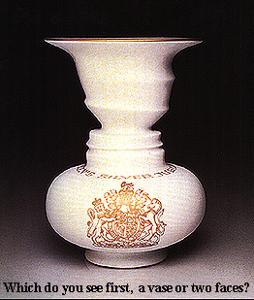
Perception

Slide 38
Organizational Behavior
(MGT-502)
Lecture-9

Slide 40
Emotions and OB Applications
Ability and
Selection
Deviant
Behavior
Leadership
Motivation
Decision
Making
Interpersonal
Conflict

